Slide 1

COMP 499/691: Conversational Artificial Intelligence
Language Models
Computer Science & Software Engineering
Concordia University, Winter 2024

Slide 2
Course Evaluation
Please, fill out the course evaluation form.
This is the official course evaluation conducted by the Centre for Teaching and Learning (CTL).
It is totally anonymous. Please, take 10 minutes to fill out this important form.
Instructions:
Open the browser, go to "My CU Account" (https://hub.concordia.ca/students/account.html) and login
On the left side menu, click on "Academic > Course Evaluation"
Choose a course to evaluate and click on "Evaluate On-line"

Slide 3
Summary of the last episode….
What we have seen last time:
Speech Recognition
Today, we will talk about language models:
N-grams
Neural Language Models
BERT

Slide 4


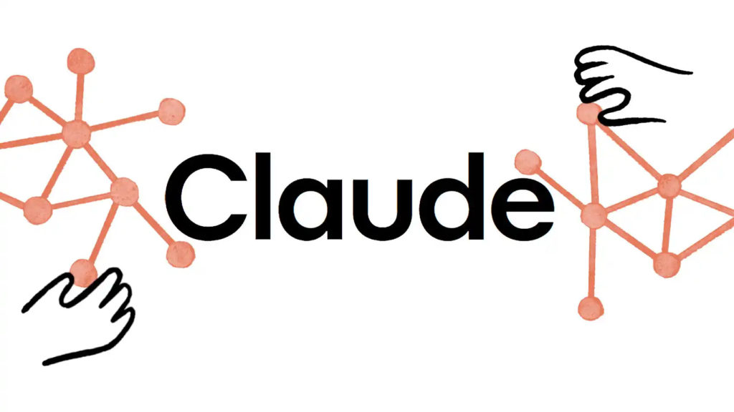

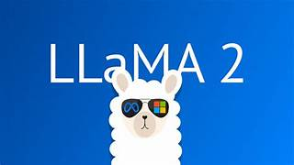
Language Models
Language models have a lot of applications:
Speech Recognition
Machine Translation
Handwriting Recognition
Natural Language Processing (dialogue, question answering, understanding)

Slide 5

Language Models
The goal of a Language Model (LM) is to assign a probability to every sequence of words w
For instance:
“The cat is on the table”
We expect the LM to assign a high probability to this sequence (as it is very plausible).
“The cat is on the bus”
We expect the LM to assign a lower probability to this sequence (as it is less plausible that the previous one).
More formally, the language model attempts to estimate the following joint probability:
P(w₁, w₂,w_{3,}...,w_{N})
How can we estimate it?

Slide 6
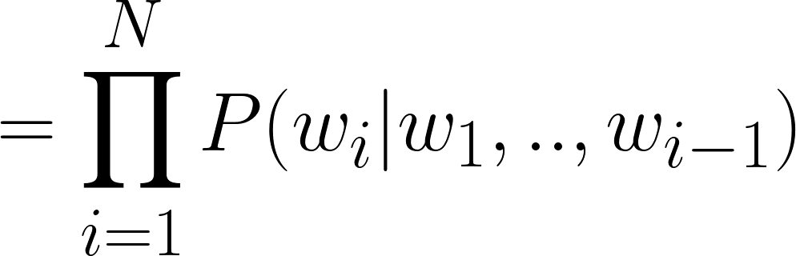
Language Models
A naive way to estimate P(w₁, w₂,w_{3,}...,w_{N}) is to count of many times a certain sequence of words arises in a large text corpus and divide by the total number of sentences.
This is not feasible. Due to the large variability of sentences, we cannot have reliable statistics.
Fortunately, we factorize the joint probability using the chain rule of probability:
A language model can be trained to predict the next word given all the previous ones.

Slide 7
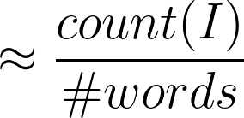
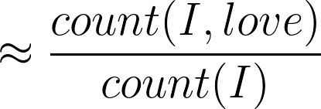
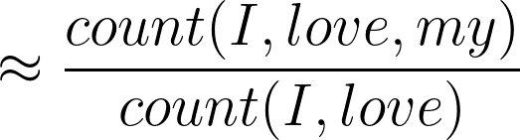
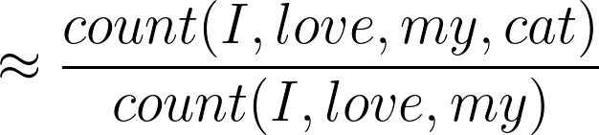
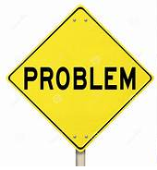
Language Models
How can we estimate all these conditional probabilities?
When we increase the history, we risk having poor statistics with the counting approach.

Slide 8
Language Models
We can mitigate this problem by truncating the history up to a certain term.
Bigram
Markov Assumption: The next word depends on fixed window of prior words.
Trigram
Limiting the history helps to get more reliable statistics.
This, however, inevitably leads to an approximation of the joint probability.

Slide 9
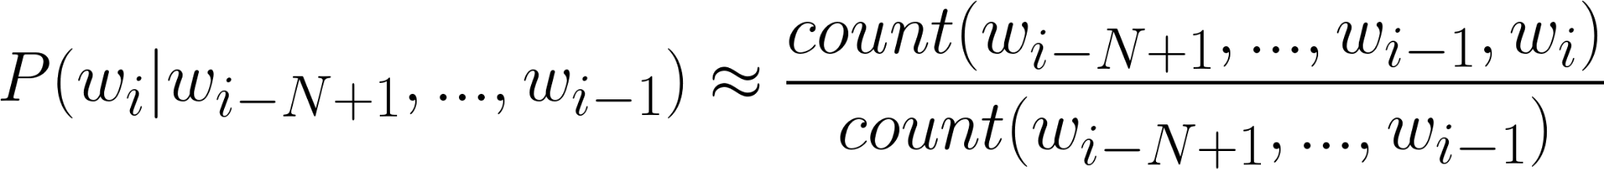
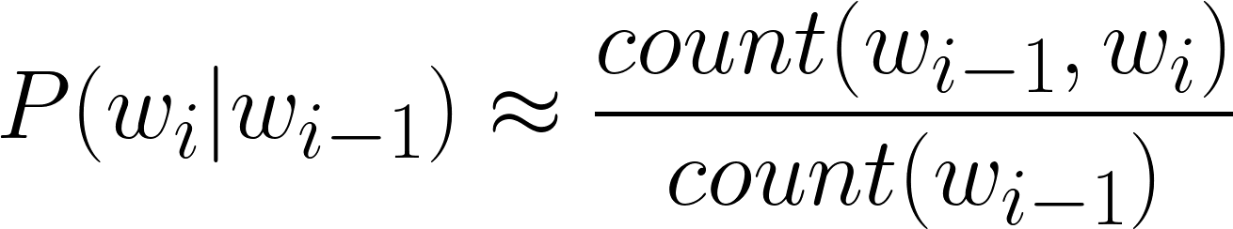
N-gram Language Models
How can we estimate these probabilities?
The maximum likelihood estimation of the n-gram probabilities is the based on counting:
For a bigram this becomes:
This ratio is called relative frequency.

Slide 10
N-gram Language Models
Let’s see an example and consider the following tiny text corpus:
<bos> I am Sam <eos>
We need to augment each sentence with <bos> and <eos>. <bos> is needed to give us the bigram context of the first word.
<bos> Sam I am <eos>
<bos> I like eggs <eos>
<bos> I do not like Sam <eos>
P(I|<bos>) = 3/4 = 0.75
P(Sam|<bos>) = 1/4 = 0.25
P(like|I) = 1/4 = 0.25
P(not|do) = 1/1 = 1.0
P(am|I) = 2/4 = 0.50
P(I|Sam) = 1/3 = 0.33
P(eggs|like) = 1/2 = 0.5
P(like|not) = 1/1 = 1.0
P(Sam|am) = 1/2 = 0.5
P(<eos>|am) = 1/2 = 0.5
P(<eos>|eggs) = 1/1 = 1.0
P(Sam|like) = 1/2 = 0.5
P(<eos>|Sam) = 2/3 = 0.67
P(do|I) = 1/4 = 0.25

Slide 11
N-gram Language Models
We learned the following statistics from the training corpus:
P(I|<bos>) = 3/4 = 0.75
P(Sam|<bos>) = 1/4 = 0.25
P(like|I) = 1/4 = 0.25
P(not|do) = 1/1 = 1.0
P(am|I) = 2/4 = 0.50
P(I|Sam) = 1/3 = 0.33
P(eggs|like) = 1/2 = 0.5
P(like|not) = 1/1 = 1.0
P(Sam|am) = 1/2 = 0.5
P(<eos>|am) = 1/2 = 0.5
P(<eos>|eggs) = 1/1 = 1.0
P(Sam|like) = 1/2 = 0.5
P(<eos>|Sam) = 2/3 = 0.67
P(do|I) = 1/4 = 0.25
We now have the following sentence: “<bos> I do not like eggs <eos>”
The joint probability of this new sentence using the bigram approximation is:
P(<bos>, I, do, not, like, eggs, <eos>) = P(I|<bos>)*P(do|I)*P(not|do)*(like|not)*P(eggs|like)*P(eos|eggs)
= 0.75*0.25*1.0*1.0*0.5*1.0 = 0.09375
Normally, to avoid small numbers we sum log-probabilities

Slide 12
N-gram Language Models
We learned the following statistics from the training corpus:
P(I|<bos>) = 3/4 = 0.75
P(Sam|<bos>) = 1/4 = 0.25
P(like|I) = 1/4 = 0.25
P(not|do) = 1/1 = 1.0
P(am|I) = 2/4 = 0.50
P(I|Sam) = 1/3 = 0.33
P(eggs|like) = 1/2 = 0.5
P(like|not) = 1/1 = 1.0
P(Sam|am) = 1/2 = 0.5
P(<eos>|am) = 1/2 = 0.5
P(<eos>|eggs) = 1/1 = 1.0
P(Sam|like) = 1/2 = 0.5
P(<eos>|Sam) = 2/3 = 0.67
P(do|I) = 1/4 = 0.25
Let’s try the sentence: “<bos> do I like eggs <eos>”
P(<bos>, I, do, not, like, eggs, <eos>) = P(do|<bos>)*P(I|do)*P(like/I)*(eggs/like)*P(eos/eggs)
= 0.00*0.00*.0.25*0.5*1.0 = 0.00
Unobserved bigrams
It looks like every time we have an unobserved bigram the joint probability is zero.

Slide 13
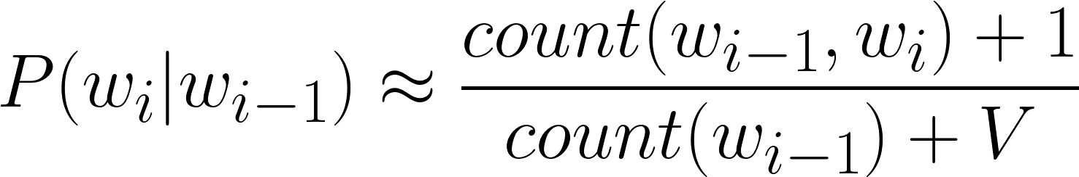
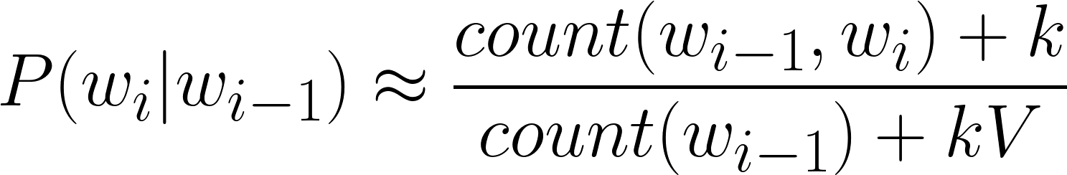
N-gram Language Models
If the words in a test set appear in an unseen context, the joint probability is zero.
To prevent that and improve generalization, we use smoothing techniques.
Many smoothing techniques have been proposed in the literature (from simple to complex ones):
Add-One Smoothing (Laplace): We add 1 to all the counts.
Number of words in the vocabulary.
Add-k smoothing: Instead of adding 1, add a number k
k is a hyperparameter to tune on a validation dataset.

Slide 14
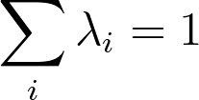
N-gram Language Models
Backoff: We consider a lower-order n-gram if we have zero probability for a higher-order n-gram.
For instance, if the trigram has zero probability, consider the bigram. If the bigram has zero probability, use the unigram.
Interpolation: By contrast, interpolation always mixes the probability estimated from all the n-grams weighting and combines the trigram, bigram, and unigram counts:
Unigram
Bigram
Trigram
The weights must sum to 1 and are hyperparameters that can be derived from a validation dataset.
Other methods: Many other methods have been proposed. A largely adopted one is the Knesser-Ney method.

Slide 15


N-gram Language Models
The main advantages and disadvantages of n-gram language models are the following:
Simplicity: N-gram language models are simple, easy to understand, and easy to implement.
Efficiency: They can be trained quickly on large datasets.
Interpretability: We can understand why the model makes its predictions, as it only relies on simple probabilistic calculations.
Limited Context: We only consider a fixed number of word history, making them unable to learn long-term dependencies.
Sparsity: The number of possible n-grams increases exponentially with n, which can lead to sparsity in the training data and a decrease in performance.

Slide 16
Neural Language Models

Slide 17
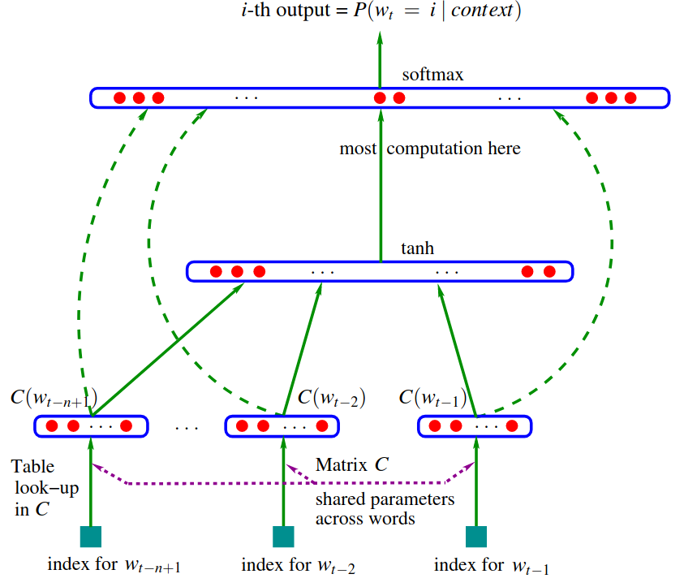

Neural Language Models
We can mitigate some of the issues of n-gram language models with neural networks.
The first neural language model was proposed by Y. Bengio in 2003 (paper)
The model used an MLP with limited history
It was the first work to realize the importance of continuous representations.

Slide 18
Neural Language Models
We can mitigate some of the issues of n-gram language models with neural networks.
We convert the word index into a learnable continuous vector (lookup table)
Word 1
Word 2
.
.
.
.
.
.
Word N
These vectors are not frozen but learned jointly with the rest of the model.
This is what we do today with torch.nn.Embedding.

Slide 19
Neural Language Models
We can mitigate some of the issues of n-gram language models with neural networks.
On top of the embeddings, we add a simple MLP with optional skip connections.
The model was trained with the Negative Log-Likelihood loss.
Despite being very simple compared to the neural networks we use today, this model was already able to outperform n-grams.

Slide 20

Neural Language Models
The main contribution of Bengio’s work is to bring attention to the crucial role of continuous representations.
The main advantage of continuous representation is that they generalize better by fighting data sparsity.
As opposed to n-grams (that word in a discrete space), generalization is obtained because a sequence of words that has never been seen before can get high probability if it is made of words that are similar (in the sense of having a nearby representation).

Slide 21

Neural Language Models
For instance, let’s consider the following sentence available in the training dataset:
The cat is walking in the bedroom
During training, we learn clusters of words that have some semantic or syntactic relation!
Let’s now consider the following unseen sentence:
A dog was running in a room
The model can assign a high-probability to it even if its bigrams are never observed.
This can happen because, in the learned continuous space, we hopefully have that:
cat
“A” and “the” are close
“bedroom” and “room” are close
dog
room
bedroom
“cat” and “dog” are close
etc
a
the

Slide 22
Neural Language Models
For years, this pioneering work went mostly unnoticed by the machine learning community.
At the time, neural networks were not popular, with support vector machines being the most commonly adopted model.
The dominant approach to language modeling still relied on n-grams.
Only after 2008, there was suddenly a renewed interest in neural language models.
In 2008, Jason Weston and Ronan Collobert extended Bengio’s work to Convolutional Neural Networks (see paper). This system was also based on multi-task learning for jointly solving language models and some supervised NLP tasks.

Slide 23
Neural Language Models
Another remarkable achievement (done by Thomas Mikolov in 2010) was the introduction of neural language models with recurrent neural networks (see paper).
I
love
my
cat
<eos>
w₁
w₂
w₃
…
w_{N}
w₁
w₂
w₃
…
w_{N}
w₁
w₂
w₃
…
w_{N}
w₁
w₂
w₃
…
w_{N}
w₁
w₂
w₃
…
w_{N}
RNNs can learn long-term dependencies.
Softmax
Softmax
Softmax
Softmax
Softmax
Linear
Linear
Linear
Linear
Linear
We have to train the RNN using a large text corpus.
RNN
RNN
RNN
RNN
RNN
The network is trained to predict the next word.
Emb
Emb
Emb
Emb
Emb
We can use the standard negative log-likelihood as a loss.
<bos>
I
love
my
cat

Slide 24
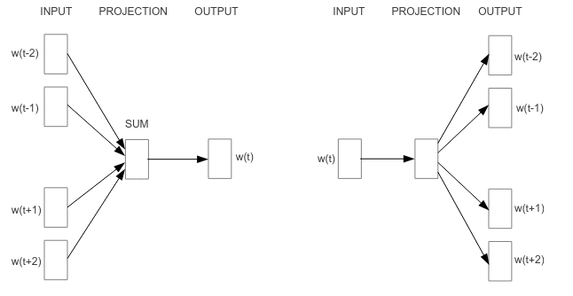
Neural Language Models
In 2013, there has been a milestone with Word2Vec (see paper).
The main contribution of this work was to simplify the neural network architecture by, for instance, eliminating non-linear elements, to enable successful training of the model on a large dataset.
This was the first successful attempt to scale up neural language models (a trend that is ongoing today).
The model is trained to solve two tasks:
1. Predict the center word based on the surrounding words
2. Predict the surrounding words given the center one.

Slide 25
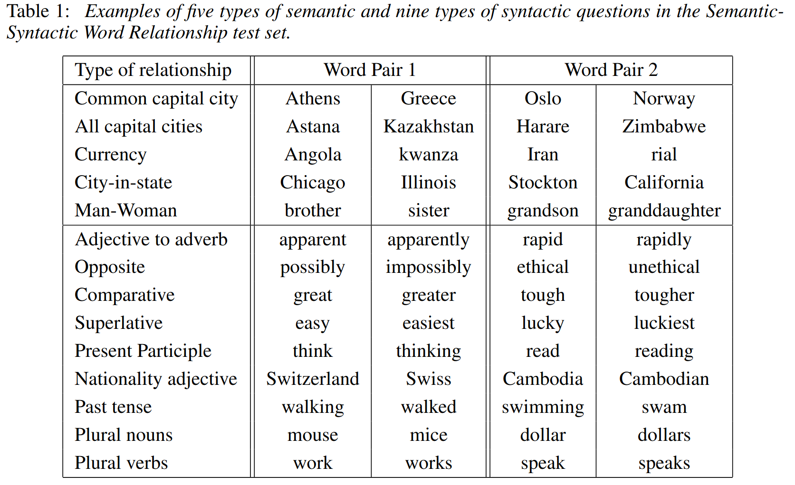
Neural Language Models
The results were pretty impressive:

Slide 26
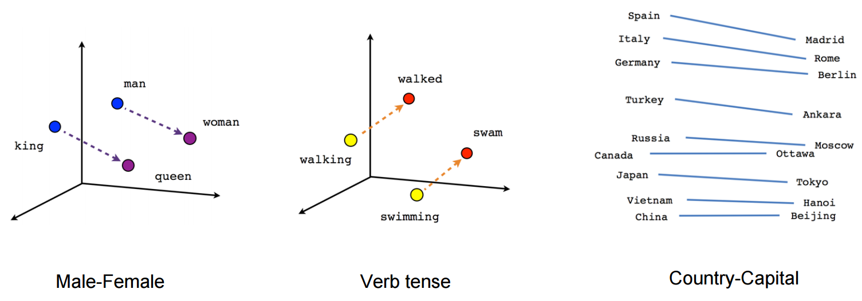
Neural Language Models
Somewhat surprisingly, the authors found that we could even do simple algebraic operations with the learned embeddings:
For instance, it was shown for example that:
vector(”King”) - vector(”Man”) + vector(”Woman”) results in a vector that is closest to the vector representation of the word “Queen”
Subsequently, several NLP tasks began to adopt pretrained word embeddings and neural networks.

Slide 27
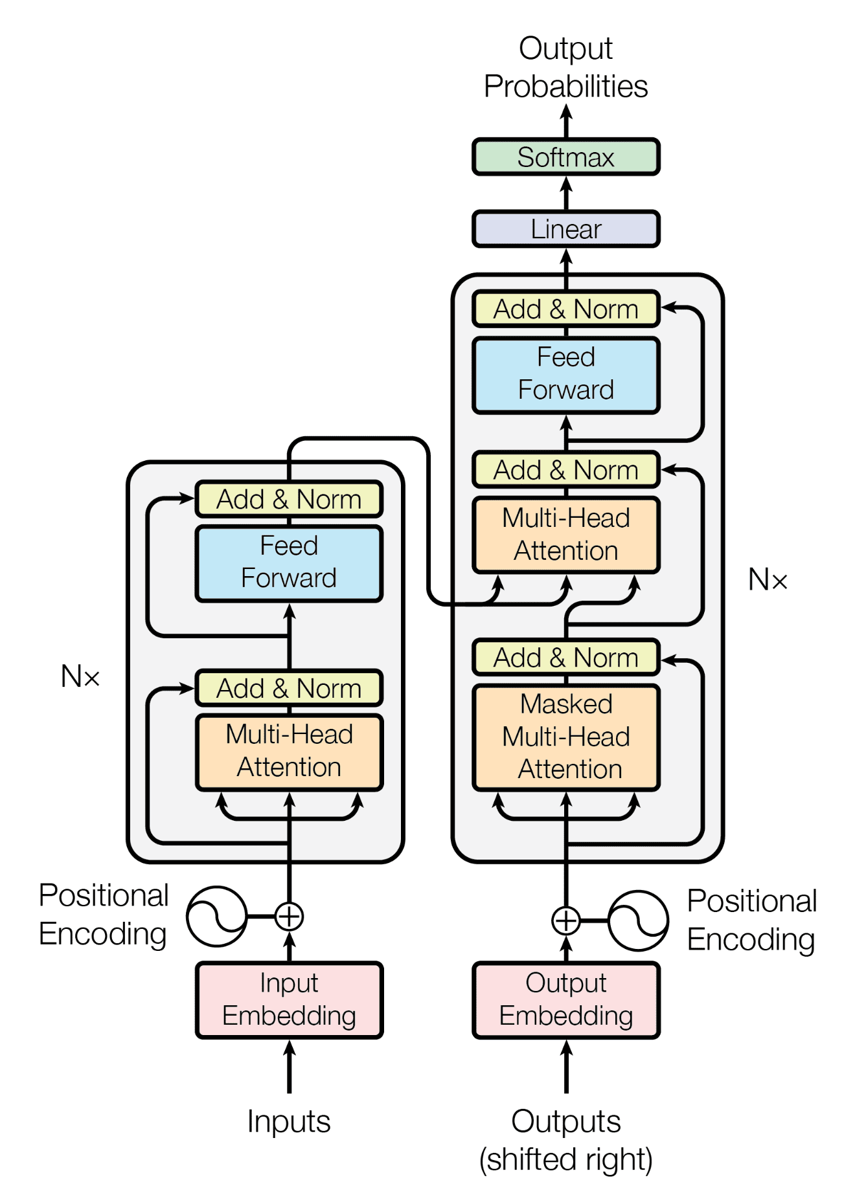
Neural Language Models
Between 2015 and 2017, we witnessed a new revolution in the NLP field with the advent of attention mechanisms.
In 2015, D. Bahdanau introduce an attention mechanism for RNN seq2seq models.
In 2017, Transformers have been proposed.
Transformers, despite being designed for sequence-to-sequence architectures, can be used for language modeling as well.

Slide 28
Neural Language Models
Transformers can be used for language modeling in the following way:
I
love
my
cat
<eos>
We only need a transformer decoder.
w₁
w₂
w₃
…
w_{N}
w₁
w₂
w₃
…
w_{N}
w₁
w₂
w₃
…
w_{N}
w₁
w₂
w₃
…
w_{N}
w₁
w₂
w₃
…
w_{N}
Softmax
Softmax
Softmax
Softmax
Softmax
We need to inject positional embeddings.
Linear
Linear
Linear
Linear
Linear
Transformer (Decoder)
Transformer (Decoder)
Transformer (Decoder)
Transformer (Decoder)
Transformer (Decoder)
We have to use masked attention to mask future elements.
Pos emb
Pos emb
Pos emb
Pos emb
Pos emb
Emb
Emb
Emb
Emb
Emb
We can use the standard negative log-likelihood as a loss.
<bos>
I
love
my
cat

Slide 29
Neural Language Models
Neural language models are normally autoregressive and can be easily used as generative models.
For example, we can sample from them to generate plausible sentences.
We can also prompt the model to continue our own sentences.
I
love
my
cat
<eos>
w₁
w₂
w₃
…
w_{N}
w₁
w₂
w₃
…
w_{N}
w₁
w₂
w₃
…
w_{N}
w₁
w₂
w₃
…
w_{N}
w₁
w₂
w₃
…
w_{N}
Softmax
Softmax
Softmax
Softmax
Softmax
Linear
Linear
Linear
Linear
Linear
Words entered by the user
RNN
RNN
RNN
RNN
RNN
Words predicted by the model
Emb
Emb
Emb
Emb
Emb
<bos>
I
love
my
cat
‹#›

Slide 30
Large Language Models

Slide 31
Large Language Models
In the last years, the community started to scale up language models massively.
A large language model is a big neural network trained with large quantities of unlabelled text.
In order to fully benefit from the advantages of scale, having large datasets and computing power alone is not sufficient.
We also require a specific type of neural network that can effectively scale.
Now, we have it!
This model is ……………….
Transformers!

Slide 32
Large Language Models
Why do Transformers scale up better than other neural networks?
Transformers scale up better than other neural networks for a few reasons:
Parallelization: at training time, all the computations can be parallelized. This makes Transformer suitable for current GPUs.
Long-term dependencies: Transformers can naturally learn long-term dependencies. They can rely on large datasets to learn generalizable long-rage patterns.

Slide 33
Large Language Models
Right after the introduction of Transformers, there was another breakthrough in language models:
Bidirectional Encoder Representations from Transformers (BERT, see paper)
BERT is a bidirectional language model.
It is not trained to predict the next word given the previous ones.
Instead, it randomly masks the input words and predicts the missing one based on a bidirectional context (masked language model):
How ___ You Today?
“are”

Slide 34
Large Language Models
The BERT architecture relies on a simple transformer:
[CLS]
how
are
you
doing
today
During training 15% of the input tokens are masked.
Transformer Encoder
The loss is the categorical cross-entropy.
[CLS]
how
are
[MASK]
doing
today
The loss is computed considering the predictions done on top of masked inputs.
This special token is used to indicate the beginning of the sentence.
This special token is used to mask the input.

Slide 35
Large Language Models
The BERT architecture relies on a simple transformer:
[CLS]
how
are
you
doing
today
Issue: the [mask] token is used at training time only.
Transformer Encoder
This might introduce a mismatch between training and inference phases.
To mitigate this, the authors propose to perform masking as follows:
[CLS]
how
are
[MASK]
doing
today
80% of times, we use [MASK].
10% of the times we use a random token.
10% the unchanged token

Slide 36
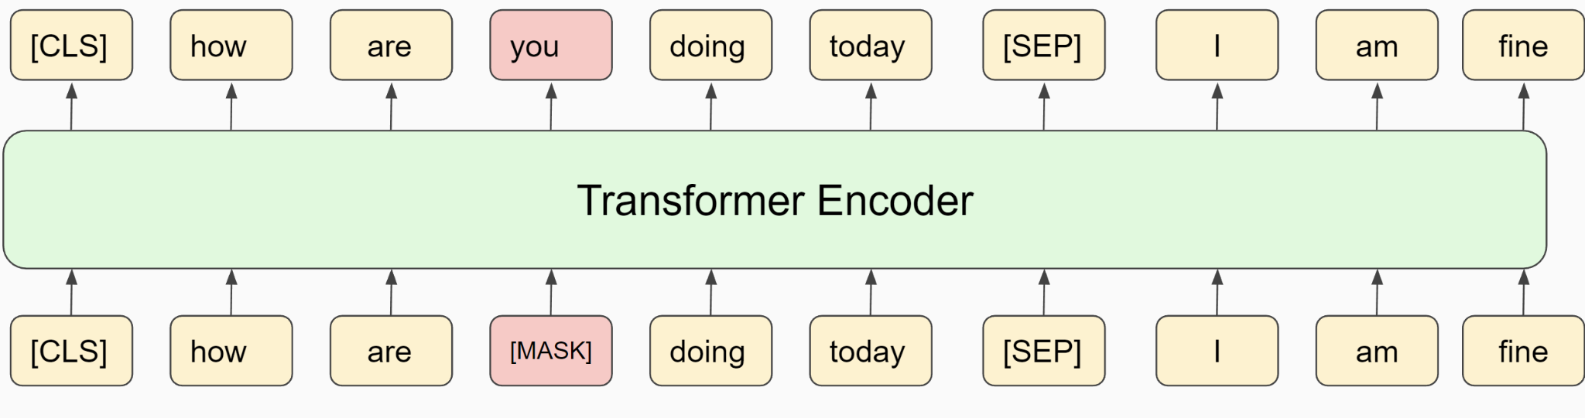
Large Language Models
Performing predictions on masked input tokens is not the only task performed in BERT.
The other one is the next sentence prediction.
The idea is to feed into the Transformer two sentences (separated by [SEP]) and a binary classifier should tell if the second one is the right next sentence or not

Slide 37
Large Language Models
We feed the right sentence continuation 50% of the times.
The other 50% of the times we just sample a random sentence.
A binary classifier should output “1” when the matching is correct, and “0” otherwise.

Slide 38
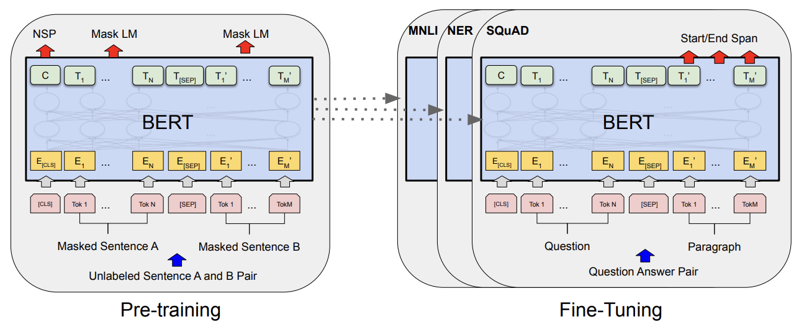
Large Language Models
If we train the model to solve the masked and the next sentence prediction, we end up learning high-level semantic embeddings in the last layer of the transformer:
We can then use these embeddings for a large variety of NLP tasks (language understanding, question answering, etc.).
As an alternative, we can fine-tune BERT along with another neural network performing the NLP task of interest.

Slide 39
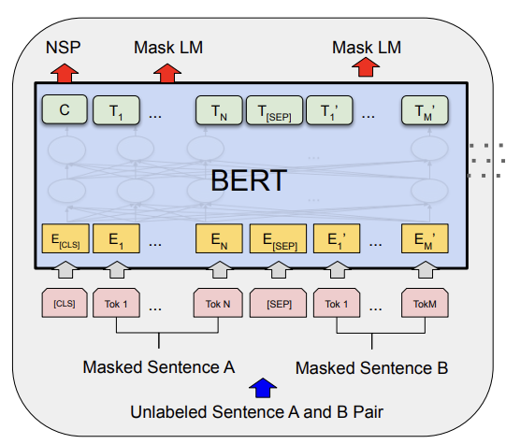
Large Language Models
A few more technicalities:
The next sentence prediction is computed using the vector C (see figure), which corresponds to the output observed when in the first input (i.e, [CLS]).
The vector C will be a fixed-size vector that summarizes the semantic content of the sentence.
2. We learn two different embeddings for sentence 1 and sentence 2.
This helps the network understand that their token refers to different sentences.

Slide 40
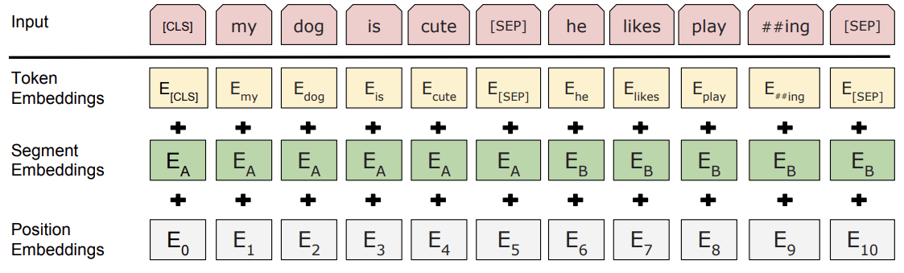
Large Language Models
The embeddings that we learn are actually the sum of token embeddings, segment embeddings and positional embeddings:

Slide 41

Large Language Models
BERT is a non-autoregressive model.
It is primarily designed for learning robust embeddings.
Can we generate text with BERT?
Even though BERT is non-autoregressive and not designed for that there are some “tricks” to sample from it.
We can feed some text input and add append to it some [MASK] tokens. BERT will fill the MASK with some text:
We can generate a prediction and then repeat the process multiple times to obtain a longer output.
How are you Today? [MASK] [MASK] [MASK]
I
am
fine

Slide 42
Large Language Models
Another approach is to fine-tune BERT on a question-answering tasks (e.g., sequence-to-sequence)
It is important to note that BERT is not really designed for text generation.
We will see other large language models such as GPT-3 that are autoregressive and can generate better text token-by-token.
Can we use BERT to rescore partial ASR hypotheses during beamsearch?

Slide 43

Large Language Models
Can we use BERT to rescore partial ASR hypotheses during beamsearch?
It is extremely computationally demanding.
This happens because the model is large and non-autoregressive.
We can do that:
For each partial hypothesis append the [MASK] symbol
This approach is known as BERT rescoring.
Hello how are [MASK]
2. Observe the probability of the output tokens where the input is masked.
3. Use this probability and interpolate with that provided by the ASR.

Slide 44

Large Language Models
This approach is known as BERT rescoring.
We need to repeat that for all the partial hypotheses until the end of beamsearch
For every partial hypothesis, BERT has to restart from scratch as the model is non-autoregressive.
As a result, despite the valuable information available in BERT, BERT rescoring is very computationally demanding and it is not normally used to rescore partial hypotheses.
It is more often used to rescore the final N hypotheses only.

Slide 45
References
[1] https://web.stanford.edu/~jurafsky/slp3/3.pdf
[2] https://www.ruder.io/a-review-of-the-recent-history-of-nlp/
[3] https://www.jmlr.org/papers/volume3/bengio03a/bengio03a.pdf
[4] http://machinelearning.org/archive/icml2008/papers/391.pdf
[5] https://www.fit.vutbr.cz/research/groups/speech/publi/2010/mikolov_interspeech2010_IS100722.pdf
[6] https://arxiv.org/pdf/1301.3781.pdf
[7] https://arxiv.org/pdf/1810.04805.pdf

Slide 46

Lab Session
During the weekly lab session, we will do:
Q&A Session about the projects
Spoken Language Understanding
Deadline: April, 2 11.59 pm

